Slide 1
Capstone-1
Testing Essential & AUTOSAR
Group No . 01
AUTOSAR integrated with Anti-lock Braking System (ABS)
Team Members :
Amar
Aakanksha
Abarna
Tarun
Trainer : Prof. Abhishek Sengupta
Date : 27th August 2024

Slide 2
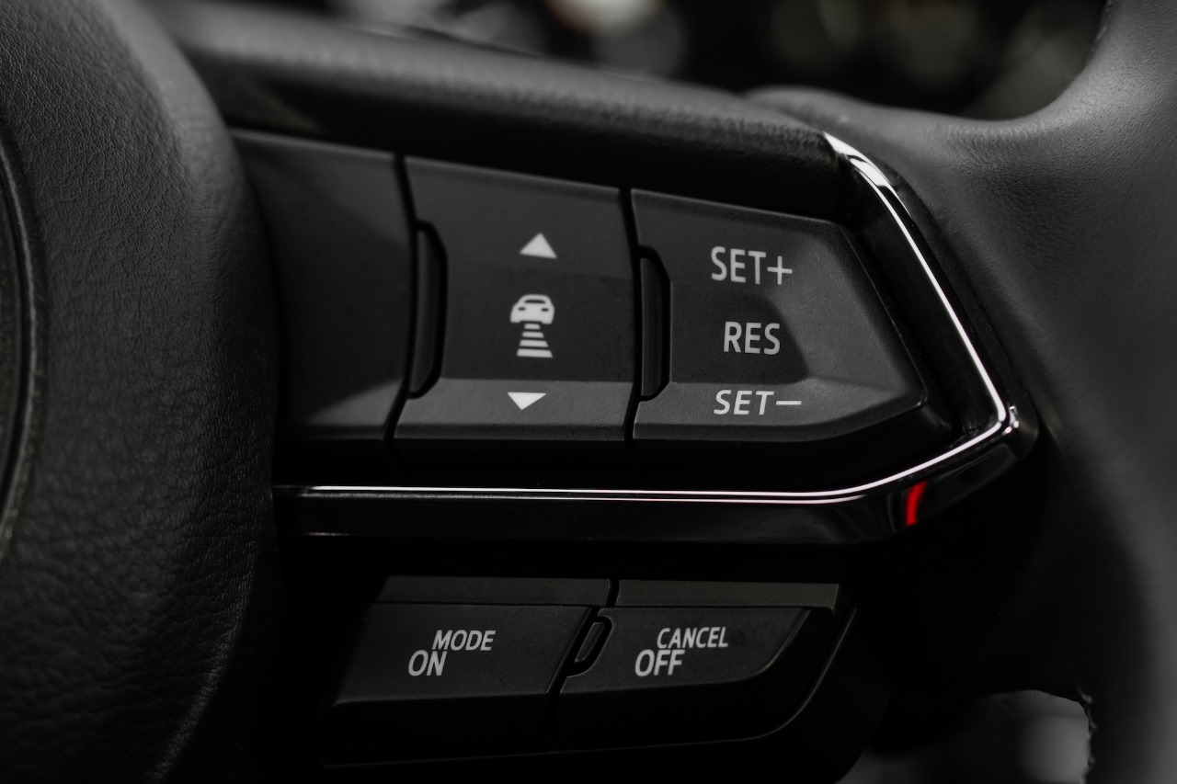
AGENDA
1. Introduction to Agile Testing Approach
2. Overview of AUTOSAR Layered Architecture Setup
3. Test Case Development and Execution
4. Functionality Flow Chart and AUTOSAR Configuration
5. AUTOSAR Simulation and Validation
6. Testing Methodologies
7. Traceability and Test Reporting
8. Conclusion and Q&A

Slide 3
INTRODUCTION OF AGILE TESTING
The Agile Testing Approach is a method used in software development that emphasizes testing throughout the entire development cycle, rather than just at the end. It aligns with Agile methodologies, which focus on iterative development, collaboration, and customer feedback. Key practices in Agile Testing include:
Sprint Planning: Defining what needs to be tested during each iteration (or sprint).
Continuous Integration (CI): Regularly merging code changes into a shared repository and automatically running tests to detect issues early.
Test-Driven Development (TDD): Writing tests before writing the code to ensure that the software meets the requirements from the start.
Sprint Retrospective and Review: Evaluating the testing process after each sprint to identify improvements and ensure the product meets quality standards.

Slide 4
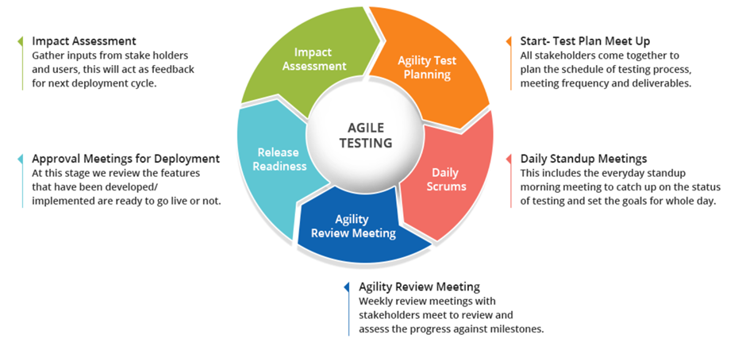
Key components and flow of the Agile Testing process.

Slide 5
OVERVIEW OF AUTOSAR LAYER ARCHITECTURE SETUP
AUTOSAR (Automotive Open System architecture) provides a standardized framework for developing automotive software. Its architecture is layered, which allows for modularity, scalability, and ease of integration. The key layers include:
Application Layer: Contains the application software components, like ABS control logic.
RTE (Runtime Environment): Acts as a middleware, facilitating communication between software components and the underlying layers.
Basic Software (BSW): Comprises services like communication, memory, and operating system functions.
MCAL (Microcontroller Abstraction Layer): Provides an interface between the microcontroller and the BSW.
ABS Application: The ABS control logic will reside in the application layer, responsible for monitoring wheel speed and controlling braking force to prevent wheel lockup.
HMI (Human-Machine Interface): The HMI will allow drivers to interact with the ABS system, displaying information like ABS status, warnings, and diagnostics.
Communication Flow:
The ABS application sends data to the RTE.
The RTE communicates with the HMI application and other components through standardized AUTOSAR interfaces.
The BSW layer handles the low-level communication, ensuring data is transmitted to and from the ABS ECU (Electronic Control Unit).

Slide 6
TESTCASE DEVELOPMENT AND EXECUTION
ABS Functionality: The ABS should prevent wheel lockup during braking, ensuring vehicle stability and control.
AUTOSAR Integration: The ABS must communicate correctly with other components via AUTOSAR, using standardized interfaces.
HMI Interaction: The driver should receive real-time feedback through the HMI when ABS is engaged.
Testcase for ABS
Test Case 1: ABS Activation on Slippery Surface
Objective: Verify that the ABS activates when the vehicle is braking on a slippery surface.
Preconditions: Vehicle is traveling at 50 km/h on an icy or wet road.
Steps:
Apply full brakes suddenly.
Monitor the ABS warning light and vehicle behavior.
Expected Result: The ABS should activate, preventing the wheels from locking up, and the vehicle should maintain steerability.
Test Case 2: ABS Functionality on Dry Surface
Objective: Verify that the ABS does not activate when the vehicle is braking on a dry surface where wheel lockup is unlikely.
Preconditions: Vehicle is traveling at 60 km/h on a dry road.
Steps:
Apply full brakes suddenly.
Observe the ABS warning light and vehicle behavior.
Expected Result: The ABS should not activate, and the vehicle should stop without the wheels locking up.

Slide 7
Test Case 4: ABS Failure Mode
Objective: Verify the vehicle's behavior when ABS fails.
Preconditions: Simulate an ABS failure (e.g., by disconnecting the ABS sensor).
Steps:
Attempt to brake normally at various speeds.
Observe the ABS warning light and vehicle behavior.
Expected Result: The ABS warning light should illuminate, indicating a system failure, and the vehicle should revert to standard braking behavior without ABS.
Test Case 5: ABS Response During Cornering
Objective: Verify the ABS functionality when braking during a turn.
Preconditions: Vehicle is traveling at 40 km/h on a curved, slippery road.
Steps:
Apply brakes during the turn.
Monitor the ABS warning light and vehicle behavior.
Expected Result: The ABS should activate to prevent wheel lockup, maintaining vehicle control and stability through the turn.

Slide 8
FUNCTIONALITY OF FLOW CHART
Initiation of ABS: The ABS system is active when the vehicle is in motion, typically controlled by the ECU (Electronic Control Unit).
Input: Each wheel is equipped with speed sensors that continuously monitor the rotational speed of the wheels.
Data Collection: The ABS controller gathers real-time data from these sensors to detect any discrepancies.
Comparison: The system compares the speed of each wheel to detect any that are decelerating much faster than others.
Action: If a wheel is detected to be at risk of locking, the ABS control unit activates.
Signal: The control unit sends a signal to the hydraulic modulator to adjust brake pressure on the affected wheel(s).
Continuous Monitoring: While modulating the brake pressure, the ABS continues to monitor wheel speeds.
Adjustment: The system keeps adjusting the brake pressure dynamically to ensure no wheel locks up while maintaining effective braking.
Ready State: The ABS system resets itself and returns to a monitoring state, ready to activate again if another lockup situation is detected.

Slide 9
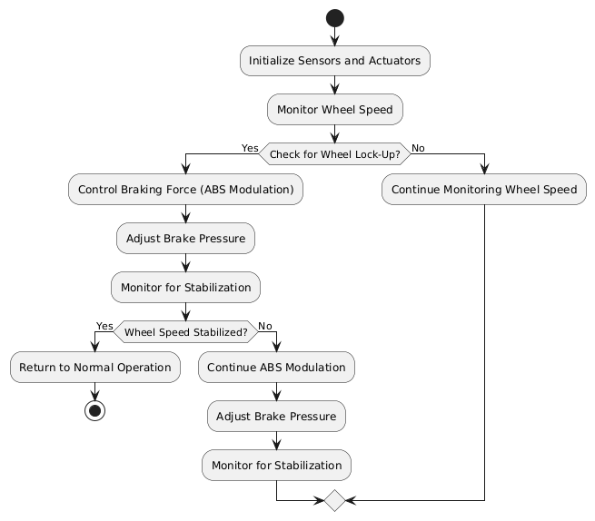

Slide 10
AUTOSAR CONFIGURATION
ECU Configuration: Configure the ECUs responsible for ABS and HMI. This involves setting up communication protocols, memory allocation, and task scheduling.
Signal Configuration: Define the signals that will be exchanged between ABS, HMI, and other systems. Configure these signals in the COM module of the BSW.
RTE Configuration: Finalize the RTE configuration to ensure all SWCs communicate correctly with each other.
AUTOSAR Compliance: Ensure the system must be compliant with AUTOSAR standards, particularly for safety-critical components.
Microcontroller Abstraction Layer (MCAL): Configure the MCAL to abstract the hardware-specific features of the ABS, such as reading wheel speed sensors and controlling actuators.
ECU Abstraction Layer: Ensure this layer is configured to manage communication between the application software and the hardware.

Slide 11
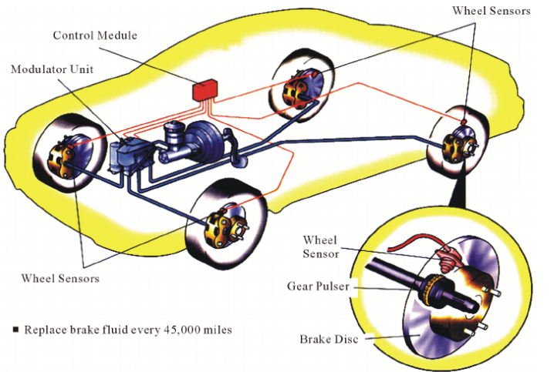

Slide 12
AUTOSAR SIMULATION AND VALIDATION
HMI Integration: If your project involves an HMI, simulate user interactions with the interface and how it impacts the underlying AUTOSAR components.
ABS Simulation: For an ABS system, simulate various driving conditions (e.g., different road surfaces, braking scenarios) and validate how the ABS software component interacts with sensors and actuators.
Requirement Traceability: Ensure that all system requirements are traced to the implemented SWCs and validated through test cases.
Automated Testing: Use tools like CANoe, CAPL, or Python scripts for automated testing of the AUTOSAR system. This helps in running regression tests and ensures consistent validation across different builds.
Test Reports and Documentation: Generate detailed test reports that document the test cases, results, and any issues encountered. This includes the test plan, test matrix, and coverage analysis.

Slide 13
TESTING METHODOLOGIES
Unit testing
Integration testing
Agile testing
Performance testing
Regression testing
User acceptance testing
System testing
Exploratory Testing

Slide 14
TRACEABILTY MATRIX
A Traceability Matrix for an Anti-lock Braking System (ABS) is a document that maps and traces the relationship between requirements, test cases, and other artifacts (such as design documents, code, etc.) throughout the lifecycle of the project. The purpose of a Traceability Matrix is to ensure that all requirements are covered by test cases and that all tests can be traced back to their corresponding requirements. This helps in identifying any gaps in testing and ensuring comprehensive coverage.
Components of a Traceability Matrix for ABS
Requirement ID: A unique identifier for each requirement related to the ABS.
Requirement Description: A detailed description of the ABS requirement.
Design Specification ID: The identifier for the design document or specification that fulfills the requirement.
Test Case ID: The identifier for the test case that verifies the requirement.
Test Case Description: A brief description of the test case.
Status: Indicates whether the requirement has been met, such as "Passed," "Failed," "In Progress," etc.
Comments: Any additional information, such as dependencies, issues, or remarks.

Slide 15
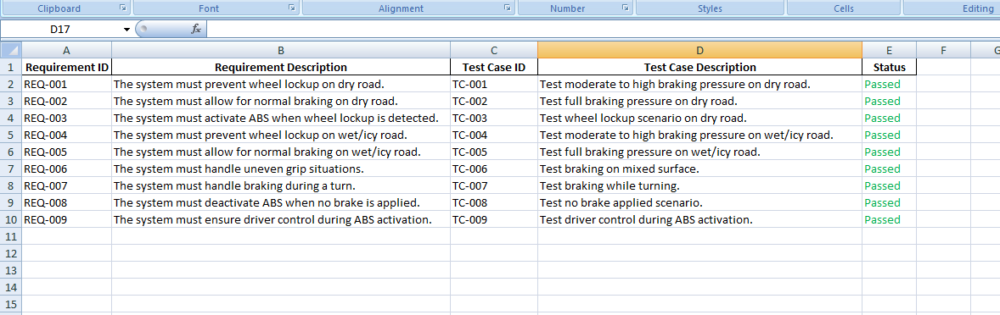

Slide 16
CONCLUSION
The successful completion of this capstone project demonstrates the effectiveness of an integrated approach to developing and testing automotive systems with AUTOSAR. By combining HMI integration, comprehensive simulations, and a well-structured testing process, we have ensured that the ABS system is reliable, safe, and ready for real-world deployment. The project not only highlights the importance of rigorous testing in the automotive industry but also sets a benchmark for future developments in AUTOSAR-integrated systems.

Slide 17
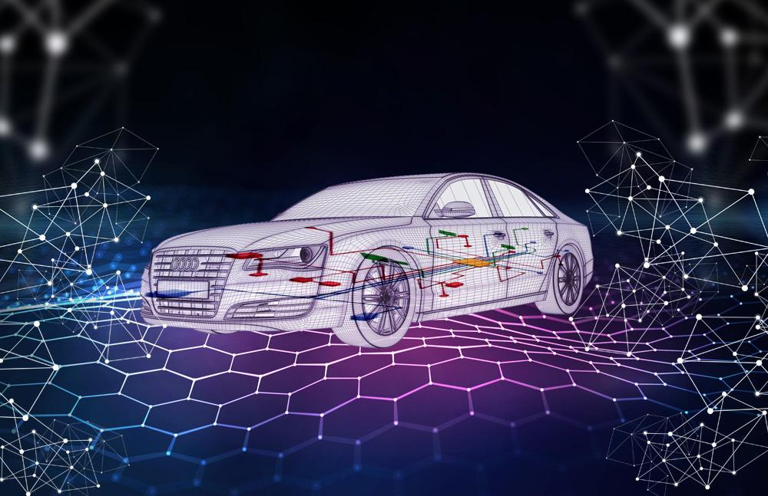
THANK YOU

